Slide 1
MMA Datathon 2023
Accelerating Instabasket shopping efficiency by allocating optimal 1000 products
Prepared by Vinicius Lourenco, Yiran Chen
October 5, 2023 - Team G Consulting Group

Slide 2
What’s Inside
Business Scenario
Data exploration
Solution
Next Steps

Slide 3
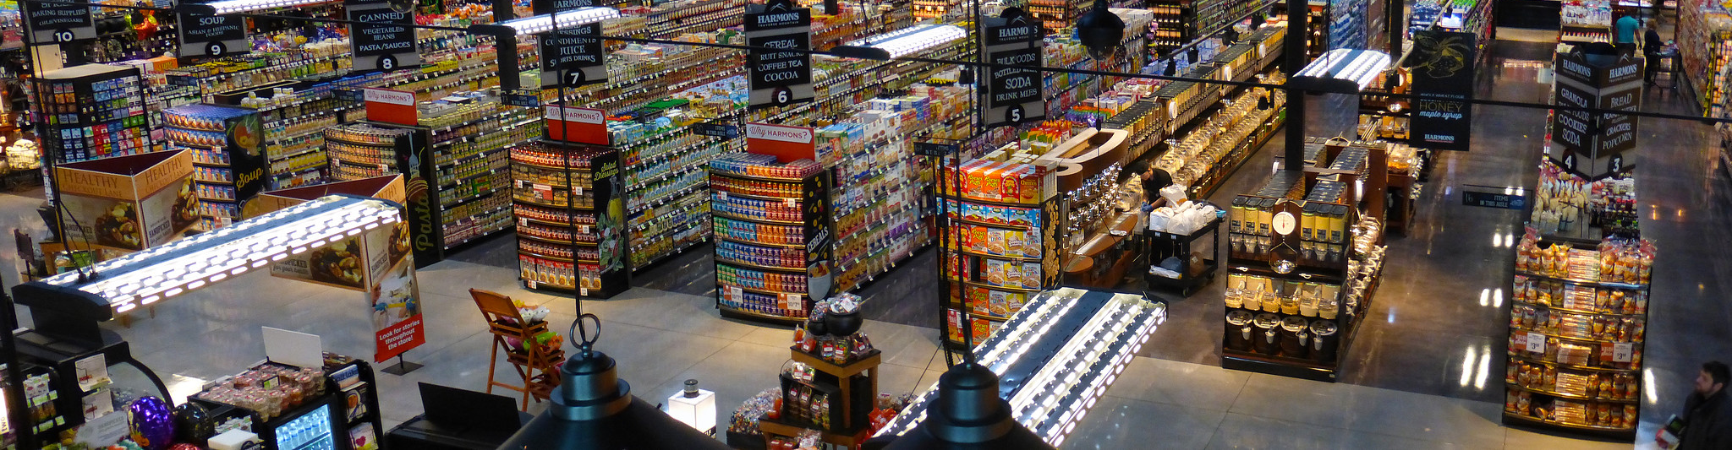
Business Scenario
MM&A Supermarket new aisle need

Slide 4

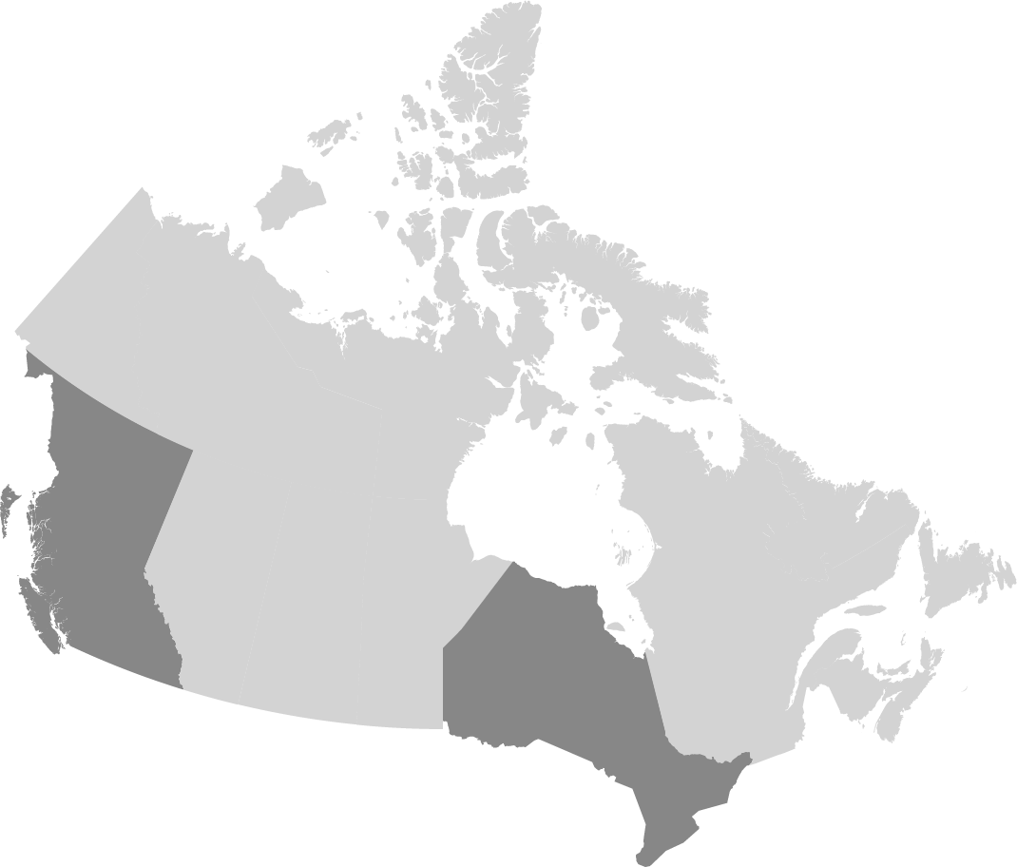

MM&A Supermarket and Instabasket Partnership
Background
Instabasket
On-demand grocery delivery service
Provide personal shoppers (PS) for end customers
Partnership
Instabasket and MM&A Supermarket systems connection
New price level for Instabasket
Details on store locations
Details on store layouts
MM&A Supermarket
National Supermarket chain (Urban/Suburban)
Ontario/British Columbia are leading provinces
Stores follow Supermarket or Hypermarket formats
Serves full lines of groceries

Slide 5
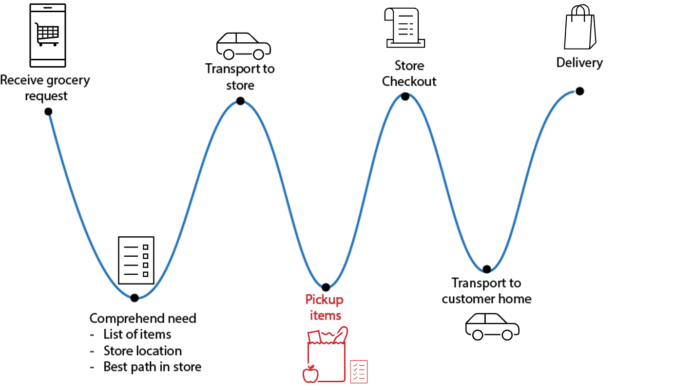
Personal Shopper Journey
Understanding the root of the necessity

Slide 6
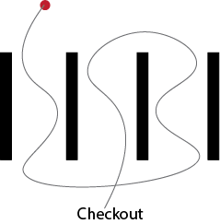
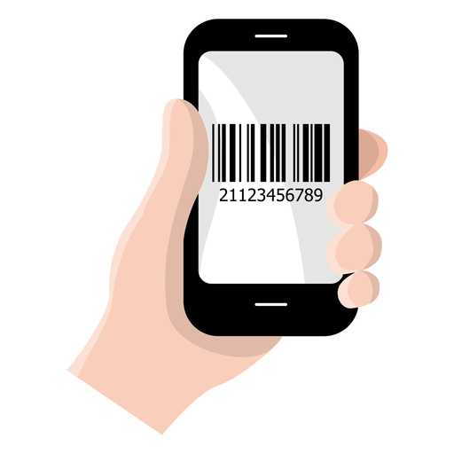
MM&A Supermarket
Opportunity
Opportunity
Stores aren’t optimized for high demand of personal shoppers
Move too fast between aisles to maximize efficiency
Regular customer’s complaints
Already Implemented
Barcode Scanning Devices / Mobile Apps
Real Time Inventory
Optimized routes within the store

Slide 7
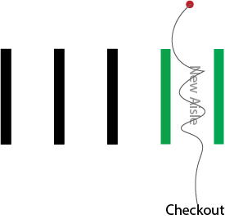
MM&A Supermarket
New Aisle Design
Implementation Needs
Select 1000 products that maximize efficiency of personal shoppers
Find a set of substitutable products to be used by personal shoppers
Expected Outcomes
Optimize the efficiency of the shopping process
Reduce the time spent on product substitutions
Provide prompt and accurate grocery deliveries and meet customer expectations
Solution
New specialized Instabasket aisle for personal shoppers.

Slide 8

Data Exploration
Getting to know the real word data

Slide 9
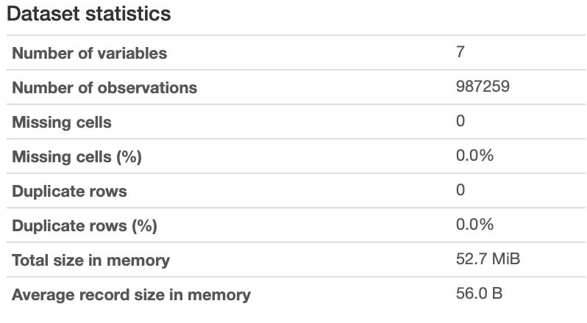
Data
Data Source - mma_mart.csv
Variables
order_id | product_id |product_name | aisle_id | aisle | department_id | department
Distinct:
Orders: 97833
Products: 35070
Departments: 21
Aisles: 134
Data Content
Provide information about orders
Include one (order | product) information per row
Include details of department and aisle per row
Assumptions
1- The data was collected before the pandemic
2- Data has statistics constant over time
Data Quality
No Duplicate rows
Some missing product ids and order ids

Slide 10
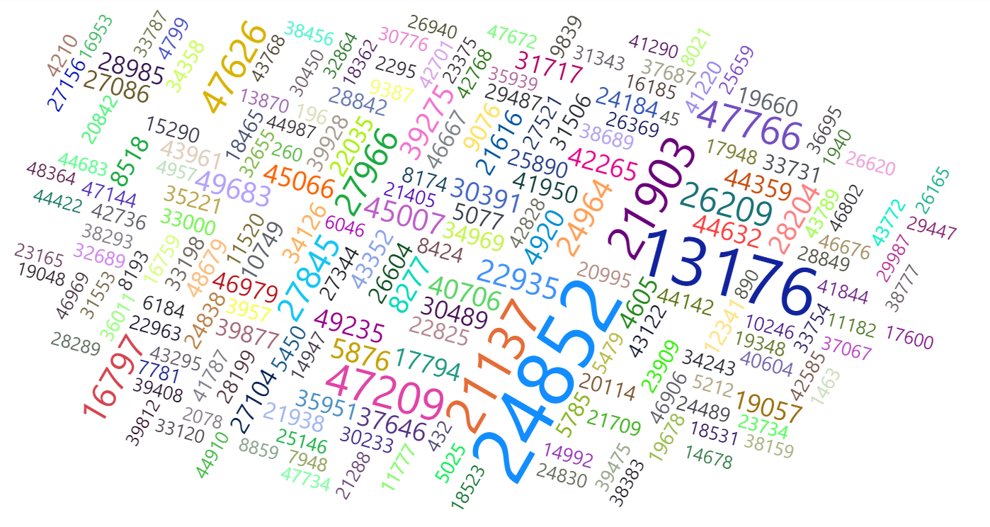
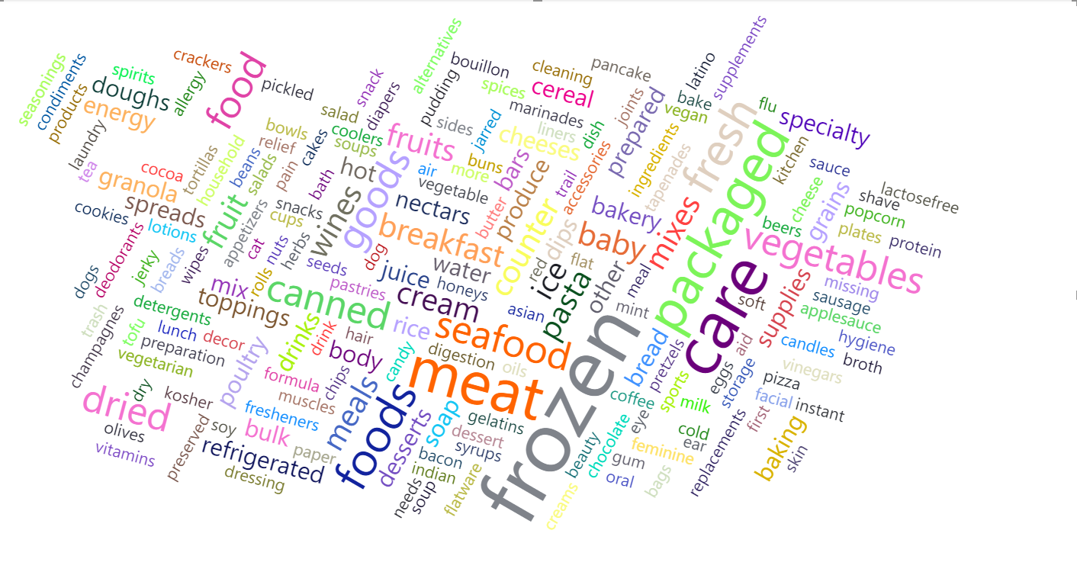
Approach
Data Profiling
Word Clouds (data source: mma_mart.csv)
Derived from the product_id column
Products that are popular:
24852 (Organic Hass Avocado)
13176 (Bag of Organic Bananas)
47209 (Organic Hass Avocado)
21903 (Organic Baby Spinach)
Keyword example: organic
Derived from the aisle column
Aisles that are popular contain keywords such as frozen, care, packaged, meat, etc.

Slide 11

Solution

Slide 12
Product Selection
The Task
1- Select the top 1000 products that maximize Instabasket personal shoppers usage.
2- Find substitutable products to maximize efficiency and reduce search time in-store.
Top 1000 products = 100 refrigerated items + 100 frozen items + 800 products
Assumption: Given MM&A Supermarket is already buying a fridge and a refrigerator, we need to fulfill them (100 items each)

Slide 13
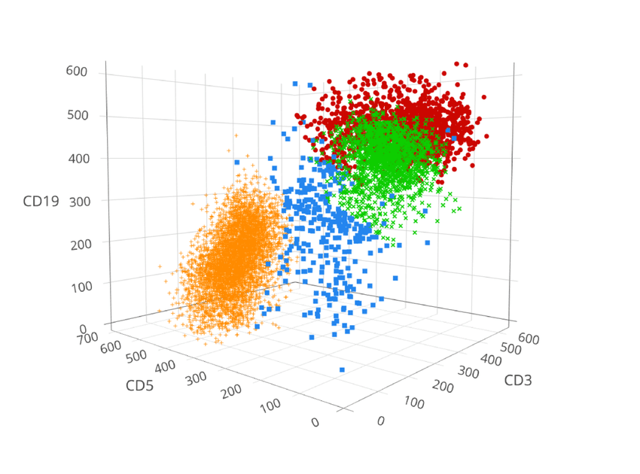
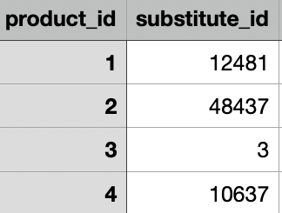
Word Pre-Processing and Clustering
How we prepare and cluster each aisle products
Clustering
(Compare all vectors and group similars)
Blue Shampoo 4 Sizing MAX!
Remove stopwords, punctuation, numbers
Blue Shampoo Sizing MAX
Lowercase words
blue shampoo sizing max
Stemming
blue shampoo size max
Remove color
shampoo size max
Vectorization
other
shampoo
size
max
Substitute Selection
(Most frequent purchase of each cluster)
[ 0 1 1 1 ]

Slide 14

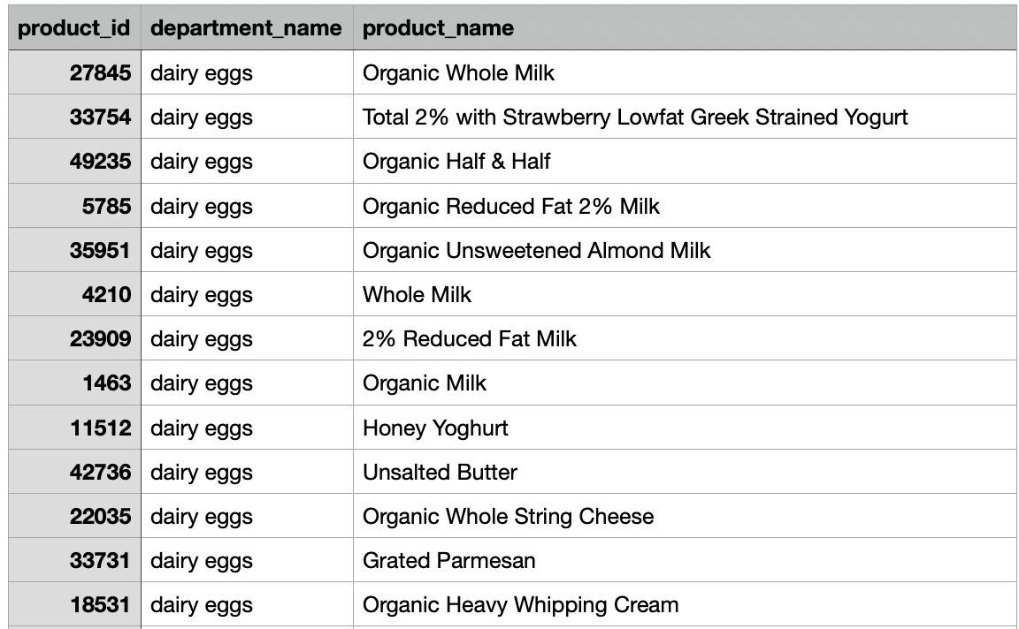
Selection of 1000 products
Using probability to our favor
Calculate frequency of products in all orders
Change products with substitute to substitute ID
Group by new product ids the frequency
Order from max to min products per frequency
Pick top
100 Frozen
Pick top
800 Overall
Pick top
100 Refrigerated
Probability Bag
Selected Products

Slide 15
Results
How great your new aisle can be (On test dataset)
Metric 1: The number of orders that utilize the in-aisle items
Metric 2: The average % of items in each order that utilize in-aisle items, accounting for any identified substitutes
Picking products
Randomly
Per frequency
(without substitute)
Per frequency
(with substitute)
7510 out of 19584 orders (38.5%) with in aisle items
17425 out of 19584 orders (88.98%) with in aisle items
18058 out of 19584 orders (92.21%) with in aisle items
Avg 0.53 in-aisle orders from avg 10.14 items in each order (5.21%)
Avg 4.13 in-aisle orders from avg 10.14 items in each order (40.77%)
Avg 5.31 in-aisle orders from avg 10.14 items in each order (52.43%)
97.71%
5.5 %
Potential (If customers accept substitutes)
88.98%
92.21%
75.23%
22.8%
38.5%
40.77%
52.43%
5.21%
Metric 1
Metric 2
Metric 1
Metric 2
Metric 1
Metric 2

Slide 16
Next Steps
MM&A Environment Evaluation
Business proposal
Implementation

Slide 17
Thank you

Slide 18
Resources
Code - https://github.com/visilvestre/mma-datathon-2023
Images – Bing.com
Produced with Adobe Illustrator
Data - Google Drive Link
Notes:
Google Drive Link: https://drive.google.com/file/d/14WEHRhSUpsyHpVefwd48OzmXEOXNxo7l/view?usp=sharing

